Slide 1
DATA WAREHOUSING CONCEPTS
1

Slide 2
WHY DATAWAREHOUSE?

Slide 3
Report : Collection of Data
Purpose: Analysis –Comparative Study of Data,
Historical Data
Final: Improve Decision

Slide 4
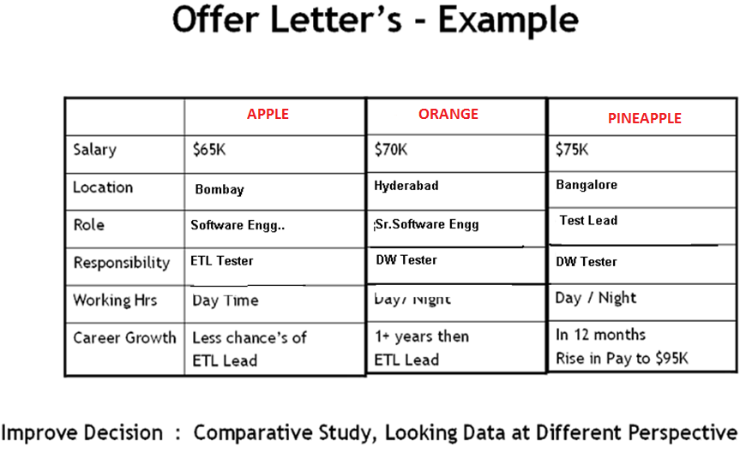

Slide 5
Multi Dimensional Analysis of Data –Reporting
Improve Decision Making

Slide 6
OLTP
ONLINE TRANSACTION PROCESSING

Slide 7
CITY BANK
Account, Loans, Mutual, Insure
Database
Multi Dimensional Analysis of data -Reporting
Capture Information:
-- Customer
-- Saving, Account
-- Insurance
T1
R1
Front End Applications
-- Java, . Net
T2
Select Statement
R2
INSERT/UPDATE/DELETE
T3
R3
T4
Transaction by Transaction
ER Entity Relationship
OLTP- Online Transactional Processing or Transactional Systems or Operational Systems

Slide 8
A data warehouse is a relational database that is designed for query and analysis rather than for transaction processing. It usually contains historical data derived from transaction data, but it can include data from other sources. It separates analysis workload from transaction workload and enables an organization to consolidate data from several sources.
What is Data Warehouse ?
A data warehouse is a relational database that is designed for query and analysis rather than for transaction processing. It usually contains historical data derived from transaction data, but it can include data from other sources. It separates analysis workload from transaction workload and enables an organization to consolidate data from several sources.

Slide 9

What is a Data Warehouse ?
A data warehouse is a subject-oriented, integrated, nonvolatile, time-variant collection of data in support of management's decisions.
- WH Inmon

Slide 10
Integrated - Characteristics of a Data Warehouse
Sale ID –Integer
Product-Char
Sales
Hyderabad
Informatica Staging
E
OLTP DB- SQL Server
Data
Warehouse
SaleID-Decimal
Product-String
L
E
Sales
Chennai
Sale ID –Numeric
Product-Varchar2
OLTP DB-Oracle Server

Slide 11
Non-volatile - Characteristics of a Data Warehouse
insert
change
Operational
Data
Warehouse
insert
delete
load
read only
access
replace
change

Slide 12
Subject-Oriented- Characteristics of a Data Warehouse
Data
Warehouse
DW is a subject-oriented database which supports the business needs of
Individual departments in the enterprise
Example : SALES,HR,ACCOUNTS,LOANS etc….
SALES
ACCOUNTS
LOANS
HR

Slide 13
Time Variant - Characteristics of a Data Warehouse
Data
Warehouse
Operational
Current Value data
time horizon : 60-90 days
Snapshot data
time horizon : 5-10 years
data warehouse stores historical data

Slide 14
Data warehouse is a database which is specifically designed for analyzing the business but not for business transactional processing.
- Ralph Kimball

Slide 15
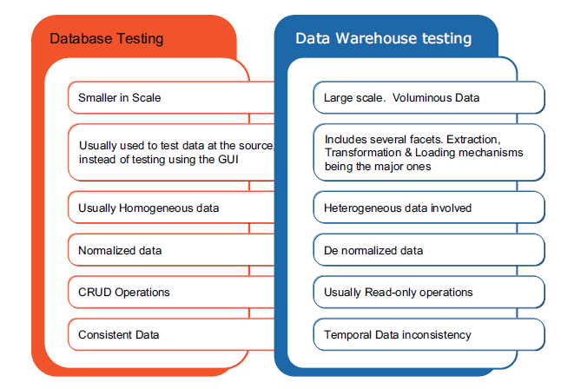
Database Testing Vs. Data Warehouse testing
OR
OLTP Vs. OLAP

Slide 16
Data Mining:
Generally, data mining (sometimes called data or knowledge discovery) is the process of analyzing data from different perspectives and summarizing it into useful information - information that can be used to increase revenue, cuts costs, or both. Data mining software is one of a number of analytical tools for analyzing data.
Data:
Data are any facts, numbers, or text that can be processed by a computer. Today, organizations are accumulating vast and growing amounts of data in different formats and different databases.
Information: The patterns, associations, or relationships among all this data can provide information
Meta Data: Data about data

Slide 17
Data mining consists of five major elements:
Extract, transform, and load transaction data onto the data warehouse system.
Store and manage the data in a multidimensional database system.
Provide data access to business analysts and information technology professionals.
Analyze the data by application software.
Present the data in a useful format, such as a graph or table.

Slide 18
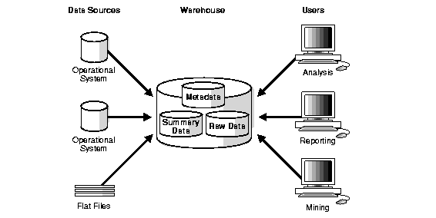
Data Warehousing Architecture (Basic)

Slide 19
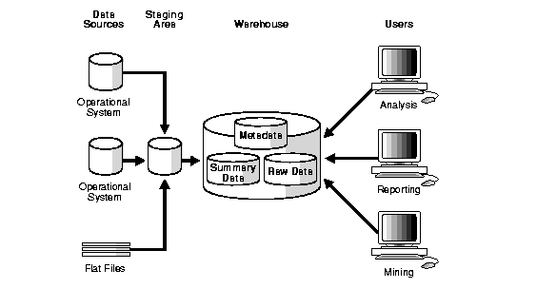
Data Warehousing Architecture (With a staging area)

Slide 20
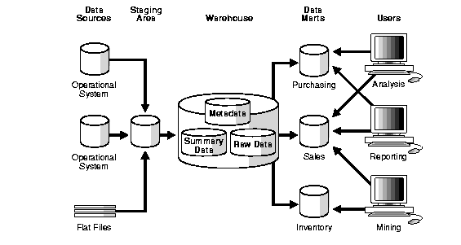
Data Warehousing Architecture
(With a Staging area and Data marts)

Slide 21
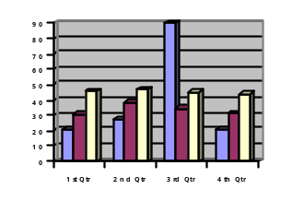
Data Warehousing Architecture
S
T
A
G
I
N
G
A
R
E
A
S
O
U
R
C
E
S
Y
S
T
E
M
S
DATA
WAREHOUSE
OLAP REPORTS
E
T
L
E
T
L
DATA
MARTS
OLAP REPORTS

Slide 22
DATA ACQUISITION
It is a process of Extracting the relevant business information,
Transforming the data into a required business format and Loading
Into the Data Warehouse.
It is defined with the following processes.
Data Extraction
Data Transformation
Data Loading

Slide 23
DATA ACQUISITION –DATA EXTRACTION
Data Extraction:
It is a process of reading the data from various types of sources
Such as relational sources, ERP sources, Mainframe sources,
XML file and Flat files.
Relational
Oracle, SQL Server,
ERP
SAP, PeopleSoft
Mainframe
COBOL Files, DB2
File
Flat Files (Text Files), XML Files

Slide 24
DATA ACQUISITION – DATA TRANSFORMATION
Data Transformation:
It is a process of cleaning the data and transforming the data into
A required business format.
The following data transformation activities take place in staging
Area.
Data Merging
Data Cleansing
Data Scrubbing
Data Aggregation

Slide 25
DATA ACQUISITION --DATA TRANSFORMATION
Data Merging:
It is a process of combining the data from multiple inputs and
Load into a single output. There are two types of Data Merging Activities.
1. Join
2. Union
Data Cleansing:
It is a process of removing unwanted data from Staging
OR
It is a process of changing inconsistencies and inaccuracies
Example : Init Cap() and Round() functions

Slide 26
DATA ACQUISITION --DATA TRANSFORMATION
Data Scrubbing:
It is a process of deriving new data definitions using existing data.
Example: Concat (First Name+ Last Name), Sal Amount=QTY*Price
Data Aggregation:
It’s process of calculating the summaries for a group of records
Using aggregate functions.
Example : Average, Max, Min etc….

Slide 27
DATA ACQUISITION --DATA LOADING
Data Loading:
It is a process of inserting the data into a target system. There are
2 types of Data Loads.
Initial or Full Load
Incremental or Delta Load
1. Initial or Full Load
It is a process of loading all the required data at very first load.
2. Incremental or Delta Load
It is a process of loading only new records after initial load.

Slide 28
Data Marts
A data mart is a simple form of a data warehouse that is focused on a single subject (or functional area), such as Sales, Finance, or Marketing. Data marts are often built and controlled by a single department within an organization.
There are 2 types of DM
1. Dependent DM
2. Independent DM

Slide 29
Data Marts
Top Down Approach or Dependent Data Marts (W.H.Inmon)
According to W.H.Inmon first we need to design an Enterprise
Data warehouse then design a small form of Subject Oriented
Department design specific DB known as Data Marts

Slide 30
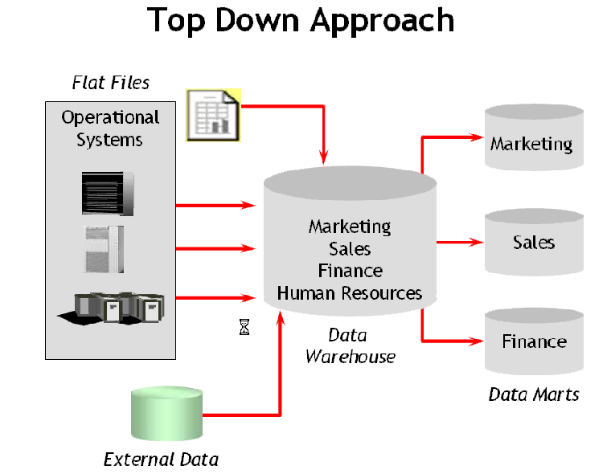

Slide 31
Data Marts
Bottom-Up Approach or Independent Data Marts (Ralph Kimball)
According to Ralph Kimball first we need to design department specific database known as Data Marts then integrate all data marts into Enterprise Data Marts.

Slide 32
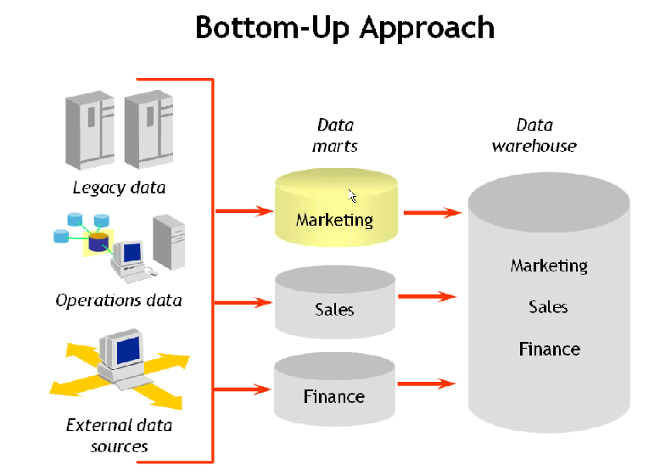

Slide 33
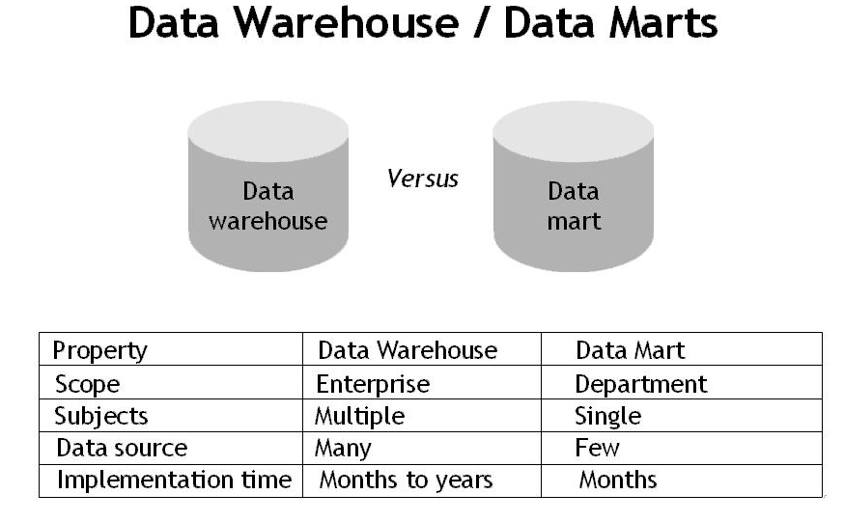

Slide 34
Schema Modeling Techniques in
Data Warehousing

Slide 35
Schema:
A schema is a collection of database objects, including tables, views, indexes, and synonyms. It contains Dimension and Fact tables

Slide 36
DIMENSION TABLES
Dimension tables contain textual information that represents the attributes of the business
Contain relatively static data
Dimension tables are joined to a fact able through foreign key reference

Slide 37
Dimension Table Examples
Retail – store name, zip code, product name, product category, day of week
Telecommunications -- call origin, call destination
Banking –customer name, account number, branch, account officer
Insurance –policy type, insured party

Slide 38
FACT TABLE
Contain numerical metrics of the business
Can hold large volumes of data
Can grow quickly

Slide 39
Fact Table Examples
Retail – number of units sold, sales amount
Telecommunications –length of call in minutes, average number of calls
Banking –average monthly balance
Insurance –claims amount

Slide 40
Types of Schemas
Star Schema
Snow Flake Schema
Fact Constellation Schema

Slide 41
STAR SCHEMA
The star schema architecture is the simplest data warehouse schema. It is called a star schema because the diagram resembles a star, with points radiating from a center. The center of the star consists of fact table and the points of the star are the dimension tables.

Slide 42
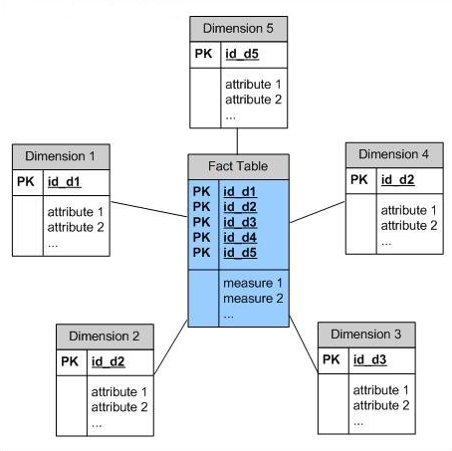

Slide 43
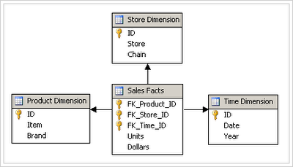
STAR SCHEMA

Slide 44
SNOWFLAKE SCHEMA
The snowflake schema architecture is a more complex variation of the star schema used in a data warehouse, because the tables which describe the dimensions are normalized. Snow flake schema are useful when there are low cardinality attributes in the dimensions .

Slide 45
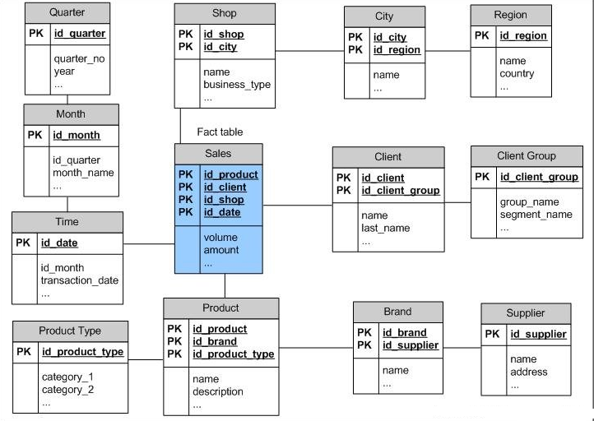

Slide 46
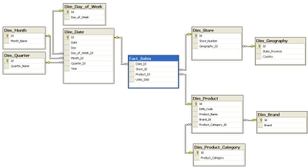
SNOWFLAKE SCHEMA

Slide 47
Fact Constellation Schema
Fact Constellation schema contains many fact tables with some common dimensions (conformed dimensions). This schema is a combination of many data marts.

Slide 48
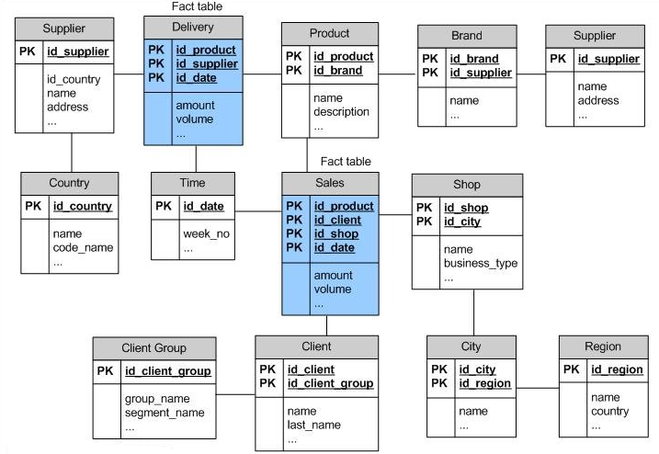

Slide 49
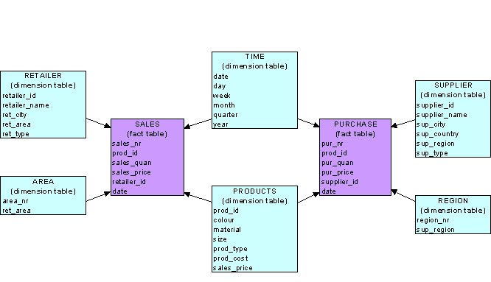
Fact Constellation Schema

Slide 50
CONFIRMED DIMENSIONS
An Dimension table which is shared across Data Mart’s or more than 1 Fact table
Example
Calendar/Date/Time –Dimension
Customer Dimension
Product Dimension

Slide 51
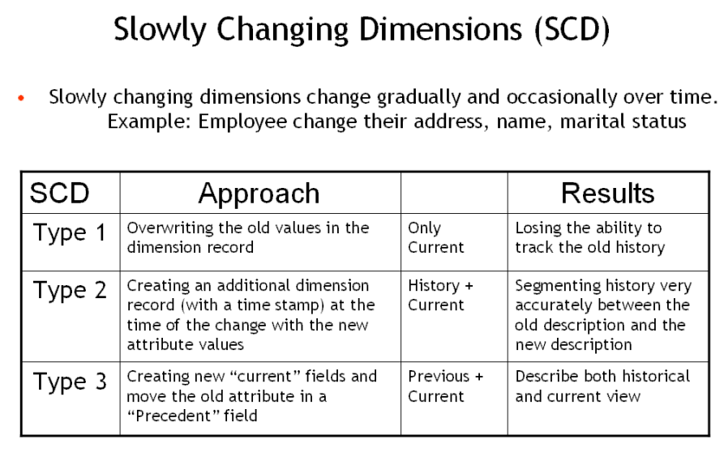

Slide 52
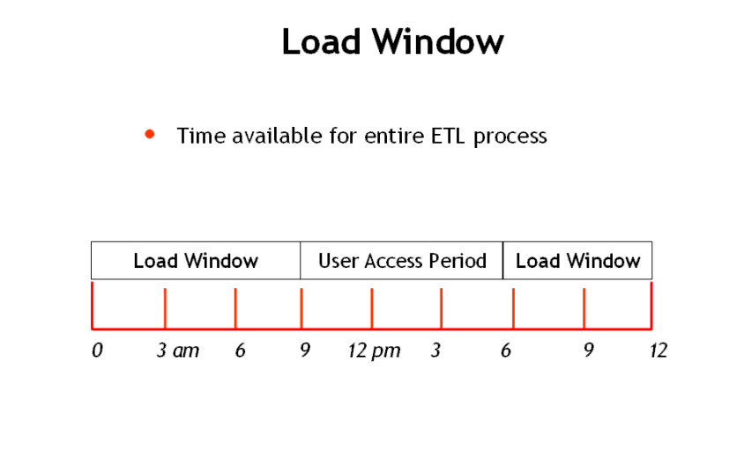

Slide 53


